Slide 1
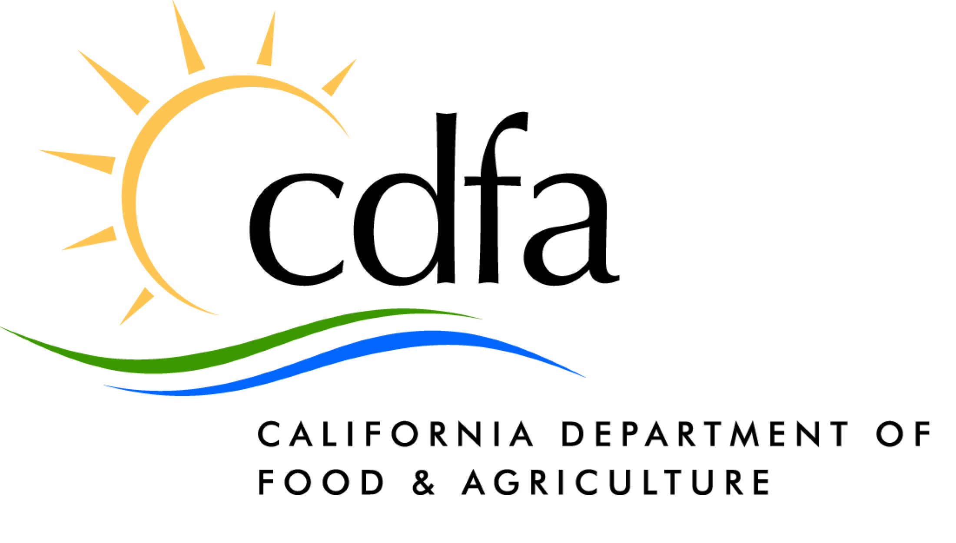
QUEENSLAND FRUIT FLY QUARANTINE
NAWAL SHARMA
Emergency Quarantine Response Program
Plant Health & Pest Prevention Services
California Department of Food & Agriculture

Slide 2
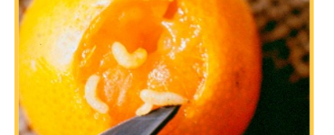
BACKGROUND
Invasive pest that feeds on 117 different fruits & vegetables.
QFF multiplies and spreads rapidly
Native to Austraila.
Larvae feed inside the fruit making it inedible

Slide 3
What Triggers a Fruit Fly Quarantine ?
One mated female, larvae or pupae - It’s an evidence of a breeding population
Quarantine is also triggered by number of adult flies captured within three miles of each other in one life cycle
Mediterranean , Melon, Caribbean Fruit Fly – 2
Mexican Fruit Fly – 5
Oriental, Guava, Peach Fruit Fly – 6 in Host Production area or 8 in Urban area
Other Exotic Fruit Flies – 2 (e.g Zeugodacus tau, QFF)

Slide 4
What Triggered Queensland Fruit Fly Quarantine in Ventura County?
2 Queensland fruit flies ( 8/23/2023 and 10/9/2023) within 3 miles of each other in one life cycle were detected in Thousand Oaks area.
3rd Queensland fruit fly was detected on 11/13/2023 in Thousand Oaks area.

Slide 5
CURRENT FRUIT FLY QUARANTINES IN CALIFORNIA , 02/22/2024
 | Z TAU Los Angeles | OFF Santa Clara | OFF Contra Costa | OFF Sacramento | OFF San Bernardino Riverside | QUEENSLAND Ventura | MEDFLY Los Angeles
QUARANTINE START DATE | 7/11/2023 | 9/1/2023 | 9/6/2023 | 9/22/2023 | 9/29/2023 | 10/23/2023 | 10/18/2023
QUARANTINE AREA (Sq. Miles) | 128 | 112 | 99 | 106 | 554 | 90 | 159
PROJECTED F3 DATE* | 6/30/2024 | 5/22/2024 | 7/12/2024 | 6/9/2024 | 7/24/2024 | 7/23/2024 | 6/25/2024
*As of 02/8/2024
Total fruit fly quarantines area =1,248 square miles

Slide 6
Top Ten Years With Most Fruit Flies in California
YEAR # FLIES
1. 2023 – 948
2. 1993 – 496
3. 1974 – 386
4. 1992 – 379
5. 2002 – 323
6. 1989 – 273
7. 1980 – 230
8. 1998 – 217
9. 1981 – 212
10. 1983 – 184

Slide 7
Why a Quarantine?
Contain a Known Pest Infestation until Eradication is Achieved
Maintain Movement and Free Trade of Pest Free Agricultural Commodities Originating/Transiting from within a quarantine Area
Reduce Domestic and Global Pressure from Trading Partners
Minimum impact to growers, nurseries and other stakeholders

Slide 8
Fruit Fly Quarantine is a Cooperative Project Between……
United States Department of Agriculture (USDA)
International and Interstate Shipments
California Department of Food and Agriculture (CDFA)
Intrastate, Inter-County and Intra-County Coordination
County Agricultural Commissioners
Intra-County and Local Government Outreach
Notes:
USDA’s main focus is to handle international and interstate shipments. They are the one who regulate Intl airports & Sea ports. CDFA’s main focus is Intrastate trade from one county to another. Counties mainly focus on local business within the county and provide outreach to local agencies.

Slide 9
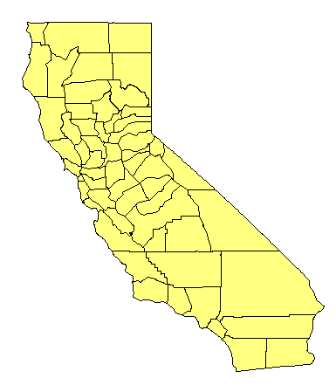
CALIFORNIA’S COOPERATIVE QUARANTINE
RESPONSE PROGRAM
CDFA/USDA
(Incident Command System)
County Ag. Commissioners
University of California
Major local commodities groups: Calif. Avocado Commission, Calif. Citrus Mutual, Citrus Research Board, Calif. Association of Nurseries and Garden Centers, etc.
Industry/Public/Others
Communication, Coordination and Cooperation
Notes:
Anytime a quarantine is placed it’s Cooperative which means it involves the “input "of different agencies. This helps in better communication, coordination and cooperation among them. Each agency has a defined role to play.

Slide 10
Quarantine Regulations State Interior Quarantine California Code of Regulation 3444 https://piˌcdfaˌcaˌgov/pqm/manual/pdf/462ˌpdf Federal Domestic Quarantine Code of Federal Regulation 301.32 https://piˌcdfaˌcaˌgov/pqm/manual/pdf/227ˌpdf

Slide 11
If Fruit Flies Are Established in California
If Exotic Fruit Flies were to establish a foothold in the continental United States, trade would be negatively impacted.
Many of our fruits, vegetables and other ag. commodities would not be permitted to be exported, affecting local and/or national economy.
Our environment could suffer as additional pesticides would be required for eradication.

Slide 12
If Fruit Flies Are Established in California
Many fruits, nuts and vegetables would drop and rot
before they were ripe
Farmers and home gardeners would need to use
more pesticides to keep crops free of fruit
fly maggots. Successful organic gardening would not
be feasible in such areas
Consumers - and that’s all of us - would pay more
for fruits and vegetables because of higher production
costs and reduced yields
Farmers would find their incomes & livelihoods in jeopardy

Slide 13
Quarantine Boundaries
Core:
One half mile radius from each find site. The small RED dots represent the find sites
Three-mile buffer:
Three-mile radius from each find site GREEN; multiple flies are considered part of the same infestation when detected within same life cycle
Four & Half mile buffer:
From the find site where quarantine boundary get established

Slide 14
California Regulatory Program Works?
In conjunction with trapping, treatment and other eradication programs- SUCCESS
Indicators----------------------------
Exotic fruit flies are NOT established in CA
FFHM from the Q. area to domestic and international markets - No interruptions
No reports of larvae detections at destination
No new infestations from the original established Q. area

Slide 15
Duration of the Quarantine
If no additional life stages are detected for 3 life cycles after the last detection
Life cycle is based on a heat degreed ay temperature driven model.
Warmer the weather shorter the life cycle and visa versa
CURRENT PROJECTED F3 date is JULY 2024 subject to extension based on the last fly find date

