Slide 1
USDA APHIS PPQ
Post Harvest Options for
Queensland Fruit Fly
Bactrocera tryoni
Host Material
Francisco Quintana
USDA APHIS PPQ

Slide 2
Post-harvest Treatment Option Suitability
When is too late to start a bait treatment cycle and finish it in the minimum required timeframe (Required number treatments during current harvest schedule)
When inside the regulatory core (within 0.5 mile of find site) and pre-harvest bait treatment is not an option

Slide 3
Post harvest options available for fresh commercial host material depend on the crop itself.
T108-a: Apple, Apricot, Avocado, Cherry, Grape, Kiwi, Nectarine, Peach, Pear, Plum, Quince
T108-b: Apple, Grape, and Pear
Methyl Bromide Fumigation PLUS Cold Treatment

Slide 4
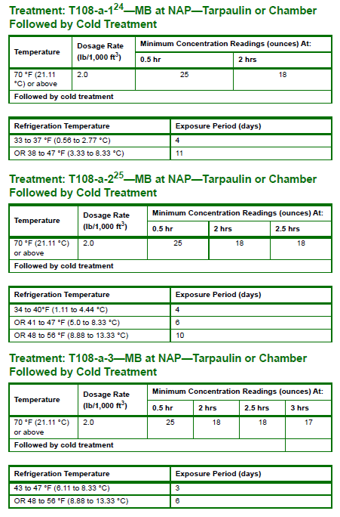

Slide 5
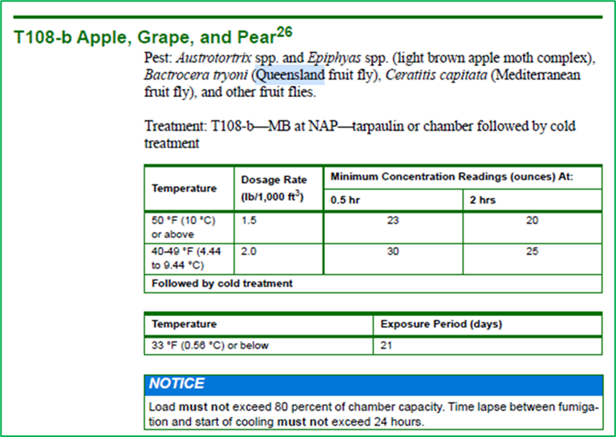

Slide 6
Challenges and Limitations of MB fumigations:
Limited fumigation providers (San Diego + Los Angeles)
Complicated logistics (transport to fumigation facilities, etc.)
Receiving county permission may be required to receive untreated material
MB may injure or reduce shelf life for some commodities depending on the temperature and dosage
High Cost
Currently looking at locations that can be approved by USDA to provide cold treatment

Slide 7
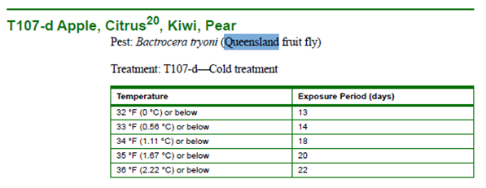
Cold Treatment ONLY options
T107-d: Apple, Citrus, Kiwi, Pear
Looking into additional other options for citrus and other crops...

Slide 8
Other post-harvest options
Juicing
Juicer must have a project issued compliance agreement and must comply with safeguarding, cleaning, and host material disposal regulations to receive this material
Host material can move safeguarded to an approved juicing facility under project issued Limited Permit
Up to the receiver to determine if they would accept the material or not – project can not force any single company to accept material for juicing/processing

Slide 9
Other post-harvest options
Irradiation - Treatment: T105-a 1—IR at 100 Gy
No irradiation facilities available in CA currently
Approved processing methods may include:
Cooking/Baking
Freezing
Canning
Crushing/Grinding
Completely Drying or dehydrating
Grounding up or Liquefying
Fresh host fruits and vegetables may not move from any property in the quarantine area unless they have been processed in a manner that eliminates the risk of spreading any life stages of fruit flies.

Slide 10
Check first with Project staff to determine if a particular method of fruit or vegetables processing complies the quarantine restrictions.
Every situation could be different, please consult the Project before taking any significant actions.
Thank you.

